Slide 1
Introduction to Network Security
Chapter 1

Slide 2
Learning Outcomes
Students must be able to explain purpose of Network Security with CIA Concepts
Students must be able to define common threats and vulnerabilities on the Internet and explain how to protect against them

Slide 3
What is Network Security?
The main purpose of network security is to protect assets
In terms of computer networks the assets can be:
  - Information – files, data streams
  - Servers
  - Configurations
  - User accounts
  - Passwords
  - Devices

Slide 4
How to protect assets? CIA
Confidentiality: Ensure that the secrecy is enforced and the information is not read by unauthorized users. Cryptography and encryption may ensure the confidentiality of the transferred data.
Integrity: modification of data or tampering of data is not permitted by unauthorized users; it provides assurance of the accuracy of information and systems. Users obtain information through authorized means (signatures).
Availability: prevention of loss of access to resources and information. Information requested has to be available to the authorized users at all times.

Slide 5
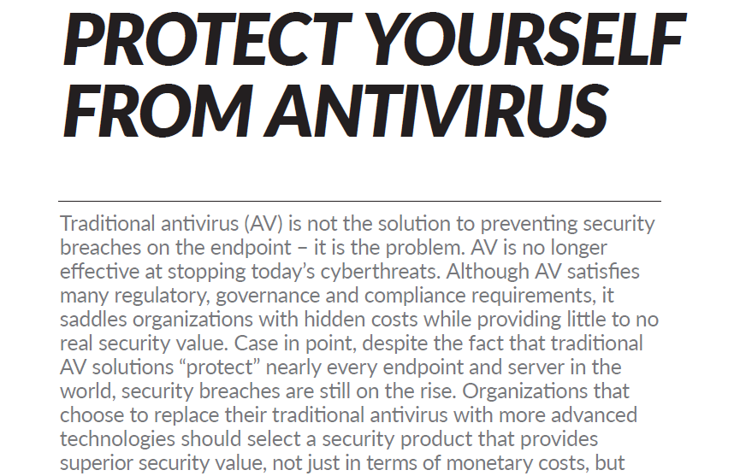
My network is protected….Are you sure?
I have the top notch Anti-Virus program on all my end point devices. Nothing can attack my network.
My firewall blocks all malicious software ports
Read this article by Palo Alto Networks for a different perspective
Notes:
The article describes something called Traps which replaces Antivirus.
So Traps uses Mutli method malware prevention techniques to prevent known and unknown threats before they compromise the endpoint.
Multi-Method Malware protection is done with Statics Analysis via Machine learning!!- which can examine a file’s characteristics and behavioural analysis in a sec and determine if it is malicious or not.
Wildfire inspection Analysis – cloud based analysis to compare unknown threats with other known threats to see pattern.
Policy based restrictions – cannot exe from outlook temp or USB Drive. Whitelisting and black listing.

Slide 6
Terminology
Vulnerability
  Is a weakness which is inherent in every network and device. E.g. routers, switches, desktops, servers.
Threat
  Is a person continually trying to exploit the weakness of the network. They use a variety of tools, scripts and programs to launch attacks against networks and devices.

Slide 7
Types of Vulnerability
Technology Weakness
  Protocols are insecure; HTTP, FTP, ICMP
  Operating system weakness ;The recent ransomeware “Wannacry” is an exploitation of the Win7 OS weakness. www.cert.org for details.
  Network equipment weakness; security holes
Configuration Weakness
  weak passwords, default settings, open access
Security Policy Weakness
  Users don’t follow written security policy, non existent policy or plan

Slide 8
Types of Threats
Structured Threats
  Come from hackers who are highly motivated and competent to seek out vulnerabilities and break the network.
Unstructured Threats
  Come from inexperienced individuals using easily available hacking tools such as shell scripts and password crackers.
External Threats
  Come from outside the company.
Internal Threats
  Come from inside the company and have physical access to servers.

Slide 9
Types of Attacks
Malware: Caused by malicious codes like virus, worms, Trojan horses
Reconnaissance attacks
Access attacks
Denial of Service (DoS) attacks

Slide 10
Malware
This is a malicious software designed to infiltrate a computer without the owner’s informed consent in order to damage, corrupt or deny access to networks and systems. This includes:
  Viruses
  Worms
  Trojan Horses
  Rootkits

Slide 11
Let’s look at some definition!
A Virus is malicious software that is attached to another program to execute a particular unwanted function on a user's workstation.
A Worm executes arbitrary code and installs copies of itself in the infected computer’s memory, which infects other hosts.
A Trojan horse is different only in that the entire application was written to look like something else, when in fact it is an attack tool.
https://www.youtube.com/watch?v=n8mbzU0X2nQ
Notes:
http://www.telegraph.co.uk/technology/5012057/Top-10-worst-computer-viruses-of-all-time.html
Viruses
A computer virus is a type of malware that propagates by inserting a copy of itself into and becoming part of another program. It spreads from one computer to another, leaving infections as it travels. Viruses can range in severity from causing mildly annoying effects to damaging data or software and causing denial-of-service (DoS) conditions. Almost all viruses are attached to an executable file, which means the virus may exist on a system but will not be active or able to spread until a user runs or opens the malicious host file or program. When the host code is executed, the viral code is executed as well. Normally, the host program keeps functioning after it is infected by the virus. However, some viruses overwrite other programs with copies of themselves, which destroys the host program altogether. Viruses spread when the software or document they are attached to is transferred from one computer to another using the network, a disk, file sharing, or infected e-mail attachments.
WormsComputer worms are similar to viruses in that they replicate functional copies of themselves and can cause the same type of damage. In contrast to viruses, which require the spreading of an infected host file, worms are standalone software and do not require a host program or human help to propagate. To spread, worms either exploit a vulnerability on the target system or use some kind of social engineering to trick users into executing them. A worm enters a computer through a vulnerability in the system and takes advantage of file-transport or information-transport features on the system, allowing it to travel unaided.

Slide 12
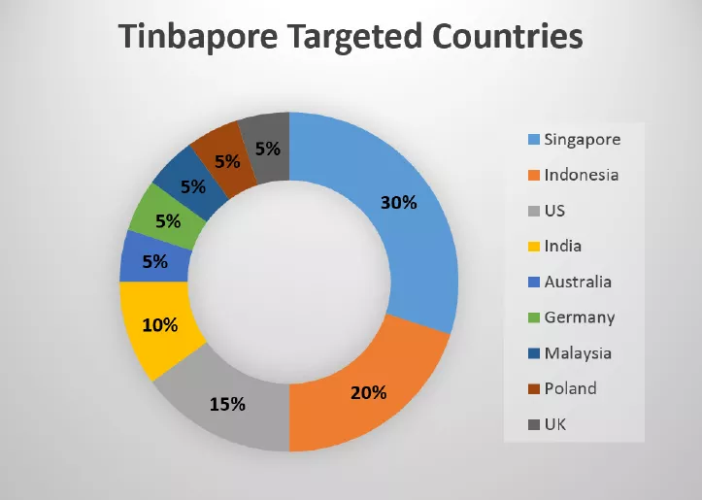
The threat is real…
2016, February: Tiny Banker Trojan (Tinba) makes headlines. (Wikipedia)
Since its discovery, it has been found to have infected more than two dozen major banking institutions, including TD Bank, Chase, HSBC, Wells Fargo, PNC and Bank of America. Tiny Banker Trojan uses HTTP injection to force the user's computer to believe that it is on the bank's website. This spoof page will look and function just as the real one. The user then enters their information to log on, at which point Tinba can launch the bank webpage's "incorrect login information" return, and redirect the user to the real website. This is to trick the user into thinking they had entered the wrong information and proceed as normal, although now Tinba has captured the credentials and sent them to its host.
http://securityaffairs.co/wordpress/43740/cyber-crime/tinba-targets-asia-pacific.html

Slide 13
Mitigating Malware
Application Whitelisting: only trusted programs can run
Patch Application: Especially OS patches on user machines
Application Hardening: Turn off unused features in MS Office, Web browsers (block Flash)
Email content filtering
Web content filtering
Deny corporate computers direct Internet connectivity.
Further reading: https://www.asd.gov.au/infosec/top-mitigations/mitigations-2017-details.htm#application
Notes:
Application Hardening:
Turn off Change language settings Settings > System > Apps & features > Manage optional features >
Settings > Devices > AutoPlay - not enabled for security reasons
Settings > Network & Internet > VPN - I have no VPN service
Settings > Network & Internet > Dial-up - I am not using dial-up

Slide 14
Types of Attacks
Malware: Caused by malicious codes like virus, worms, Trojan horses
Reconnaissance attacks
Access attacks
Denial of Service (DoS) attacks

Slide 15
Reconnaissance Attacks
Reconnaissance attacks can use various tools and techniques for example:
Packet sniffers(Eavesdropping)
A packet sniffer is a software application that uses a network adapter card in promiscuous mode to capture all network packets that are sent across a LAN.
Packet sniffers can only work in the same collision domain as the network being attacked.
Promiscuous mode is a mode in which the network adapter card sends all packets that are received on the physical network wire to an application for processing.
Wireshark is an example of a packet sniffer

Slide 16
Reconnaissance Attacks
Ping Sweeps and Port Scans
A ping sweep, or ICMP sweep, scans to determine which range of IP addresses map to live hosts.
A port scan consists of sending a message to each port, one port at a time.
  Response received indicates whether the port is used and can therefore be probed for weakness

Slide 17
Reconnaissance Attacks
Internet Information Queries
DNS queries can reveal information such as who owns a particular domain and what addresses have been assigned to that domain.
Use tools such as whois, nslookup
Video on Reconnaissance Attacks https://www.youtube.com/watch?v=YyQopOYlaEw

Slide 18
Mitigating Reconnaissance
Using encryption that meets the data security needs of the organization without imposing an excessive burden on the system resources or the users.
Ping sweeps can be stopped if ICMP echo and echo-reply are turned off on edge routers
Using intrusion prevention systems (IPS) at network and host levels (more later)
Anti sniffer tools detect changes in the response time of hosts to determine whether the hosts are processing more traffic than their own traffic loads would indicate

Slide 19
Types of Attacks
Malware: Caused by malicious codes like virus, worms, Trojan horses
Reconnaissance attacks
Access attacks
Denial of Service (DoS) attacks

Slide 20
Access Attacks
These attacks exploit vulnerabilities in the authentication service to retrieve sensitive date, gain access or escalate their access privileges.
Types of Access Attacks
  Password Attacks
  Trust exploitation
  Port redirection
  Man-in-the middle
  Social engineering
  Phishing

Slide 21
Access Attacks
Password attacks can be done in the following ways:
  Brute-force or Dictionary attacks
  Trojan horse programs (keylogger)
  IP Spoofing
  Packet sniffers (wireshark)
Trust Exploitation
  If one system is down, then the other systems in the same trust network will be affected. DNS, SMTP and HTTP are usually in the same network segment an are vulnerable if any one is infected

Slide 22
Access Attacks
Port redirection is a type of trust exploitation attack that uses a compromised host to pass traffic through a firewall that would otherwise have been dropped.
  Port redirection bypasses the firewall rule sets by changing the normal source port for a type of network traffic.
  You can mitigate port redirection by using proper trust models that are network-specific.
  Assuming a system is under attack, an IPS can help detect a hacker and prevent installation of such utilities on a host.

Slide 23
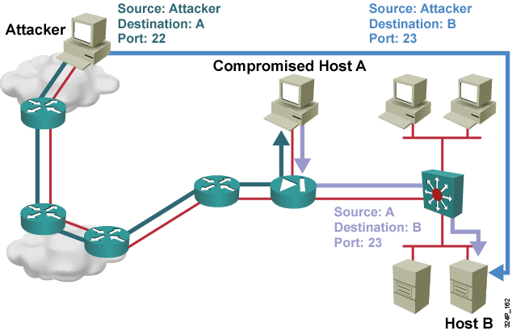
Access Attacks
Notes:
The host outside the network can reach the host on the public services segment (Host A), but not the host on the inside (Host B). The host on the public services segment can reach the host on both the outside and the inside. If hackers are able to compromise the public services segment host, they can install software to redirect traffic from the outside host directly to the inside host. Though neither communication violates the rules that are implemented in the firewall, the outside host has now achieved connectivity to the inside host through the port redirection process on the public services host. An example of an application that provides that type of access is Netcat.

Slide 24
Access Attacks
Social Engineering involves an intruder trying to extract confidential information from an insider in an organisation through social conversation. Information such as location of files, servers, passwords if leaked can cause havoc.
Phishing is a type of social engineering attack that involves email or other types of messages in an attempt to trick people into providing sensitive information such as credit card numbers or passwords.

Slide 25
Mitigating Access Attacks
Mitigating password attacks and social engineering attacks
Use “strong” passwords that are at least eight characters long and contain uppercase letters, lowercase letters, numbers, and special characters.
Disable accounts after a certain number of unsuccessful login attempts.
Do not disclose vital information to suspicious personnel
Do not click on suspicious emails or web URLs

Slide 26
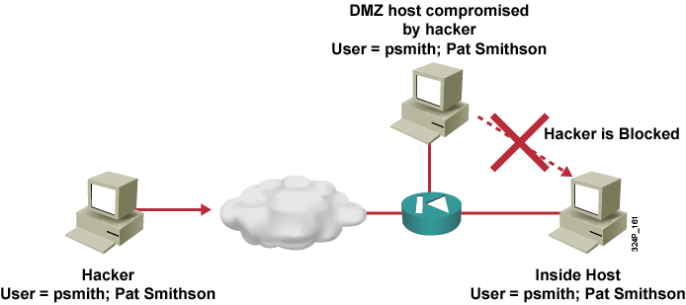
Mitigating Access Attacks
Mitigating trust exploitations
Trust levels within a network should be tightly restrained by ensuring that systems inside a firewall never absolutely trust systems outside the firewall.
IDS/IPS implementation (more later)

Slide 27
Types of Attacks
Malware: Caused by malicious codes like virus, worms, Trojan horses
Reconnaissance attacks
Access attacks
Denial of Service (DoS) attacks

Slide 28
Denial of Service Attacks
DOS attacks are designed to saturate network links with spurious data. This data can overwhelm an Internet link, causing legitimate traffic to be dropped.
Distributed DoS uses attack methods similar to standard DoS attacks but operates on a much larger scale. Typically hundreds or thousands of attack points attempt to overwhelm a target.
Mirai botnet DDOS malware
https://www.incapsula.com/blog/malware-analysis-mirai-ddos-botnet.html

Slide 29
DDOS Example: Smurf Attack

Slide 30
DDOS Example: Smurf Attack
This attack sends a large number of ICMP requests to directed broadcast addresses, all with spoofed source addresses on the same network as the respective directed broadcast.
  If the routing device delivering traffic to those broadcast addresses forwards the directed broadcasts, all hosts on the destination networks send ICMP replies, multiplying the traffic by the number of hosts on the networks.
  On a multi-access broadcast network, hundreds of machines might reply to each packet.

Slide 31
Mitigating DDOS
Anti-DoS features on routers and firewalls:
  Proper configuration of anti-DoS features on routers and firewalls can help limit the effectiveness of an attack.
  These features often involve limits on the amount of half-open TCP connections that a system allows at any given time.
Anti-spoof features on routers and firewalls:
  Proper configuration of anti-spoof features on your routers and firewalls can reduce your risk of attack.
  These features include an appropriate filtering with access lists, unicast reverse path forwarding that looks up the routing table to identify spoofed packets, disabling of source route options, and others.

Slide 32
THE END

